Slide 1
规格书
Specification
Customer Name 客户名称:成都惠利特自动化科技有限公司
Part No. 产品名称:868Mhz_915Mhz_弹簧天线
Customer P/N 客户料号:
Supplier Name 供应商名称:中科伟业(成都)通信有限公司
Supplier P/N 供应商料号:671220600501
Made 制作 | Check 审核 | Approve 批准
林嵩皓 | 代果 | 刘伟
Sample Date 送样日期 | Version 版本号
2025.08.05 | V1

Slide 2
版本更改记录
Revise Record
版本号 Version | 变更记录 Record of change | 拟制 Made | 批准 Approve | 日期 Date
V1 | 首次发行 | 林嵩皓 | 刘伟 | 2025.08.05
备注： 1、更改产品指标时，版本号需更换（V1 换为 V2、V3……）；

Slide 3
目录
 |  | Revise Record 版本更改记录
1 |  | 2D Drawing & Product Picture 2D图纸以及实物照片
2 |  | Antenna Specification 天线规格
 | 2.1 | Electrical Specification 电气规格
 | 2.2 | Mechanical Parameter 机械参数
 | 2.3 | Environment Specification 环境规格
3 |  | Passive Test Data 无源测试数据
 | 3.1 | VSWR / Smith chart / Return loss 驻波比/史密斯圆图/回波损耗
 | 3.2 | Test System 测试系统
 | 3.3 | Efficiency & Gain 效率&增益
 | 3.4 | 2D Radiation Model - 2D 辐射模型
 | 3.5 | 3D Radiation Model - 3D 辐射模型

Slide 4
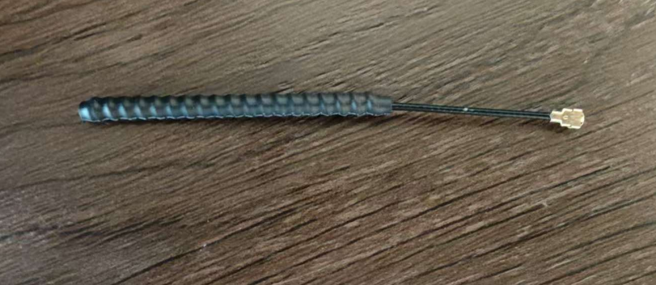
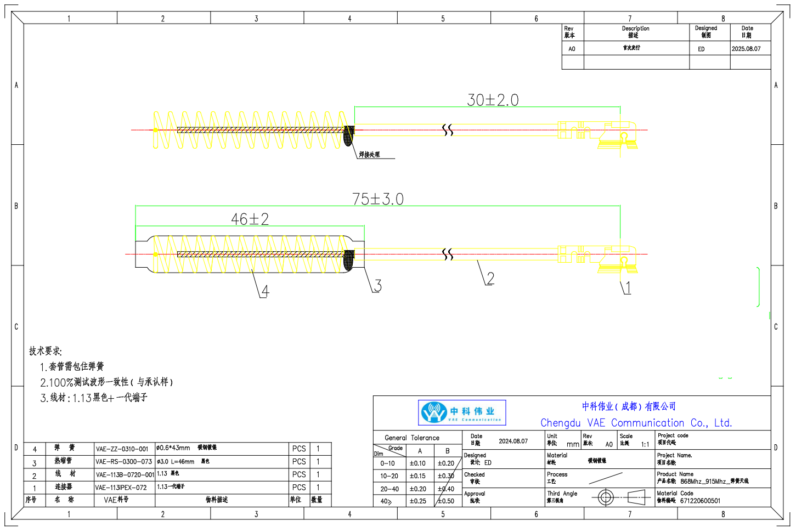
1. 2D Drawing & Product Picture 2D图纸以及实物照片

Slide 5
2. Antenna Specification 天线规格
2.1. Electrical Specification 电气参数
Electrical Specification 电气参数
频率范围 Operation Frequency (MHz) | 860-920
输入阻抗 Impedance (Ohms) | 50
驻波比 VSWR | 860-920≤ 2.0
效率 Efficiency (%) | 860-920：48.12
峰值增益 Peak Gain (dBi) | 860-920：3.01
辐射方向 Radiation Properties | Omnidirectional 全向
极化方式 Polarization | Vertical Polarization 垂直极化
功率容量 Max input Power (Watts) | 50

Slide 6
2.2 Mechanical Parameter 机械参数
Mechanical Parameter 机械参数
Structure Type 结构方式 | 弹簧天线
Dimension 尺寸 | L75, 30, 46MM
Material 材料 | 碳钢镀镍
Salt Spray 盐雾测试 | 48H
2.3 Environment Specification 环境规格
Environment Specification 环境规格
Operating temperature 工作温度 | -40℃～+80℃
Storage temperature 存储温度 | -40℃～+80℃

Slide 7
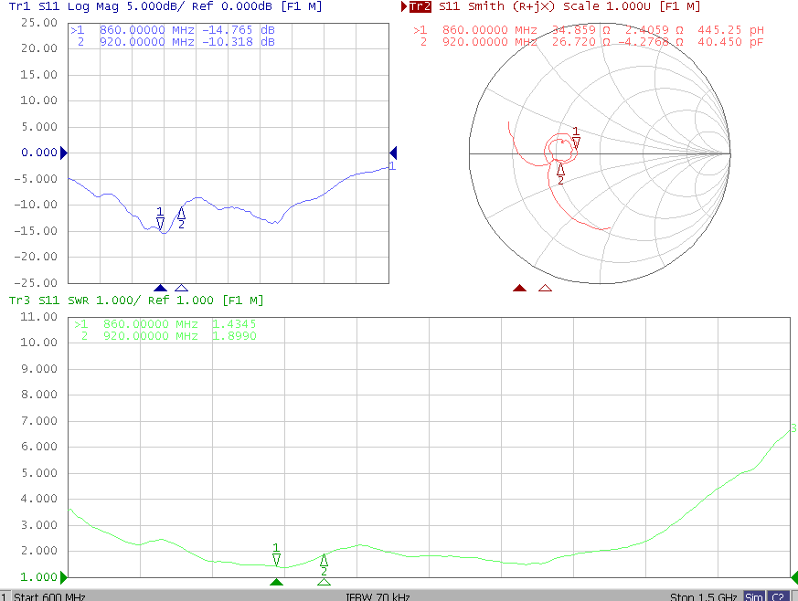
3. Passive Test Data 无源测试数据
3.1. VSWR / Smith chart / Return loss 驻波比/史密斯圆图/回波损耗
860MHz-920MHz

Slide 8
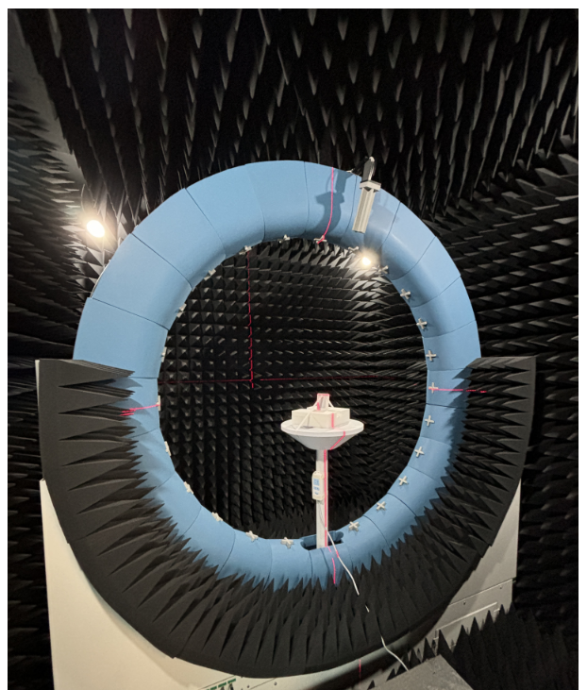
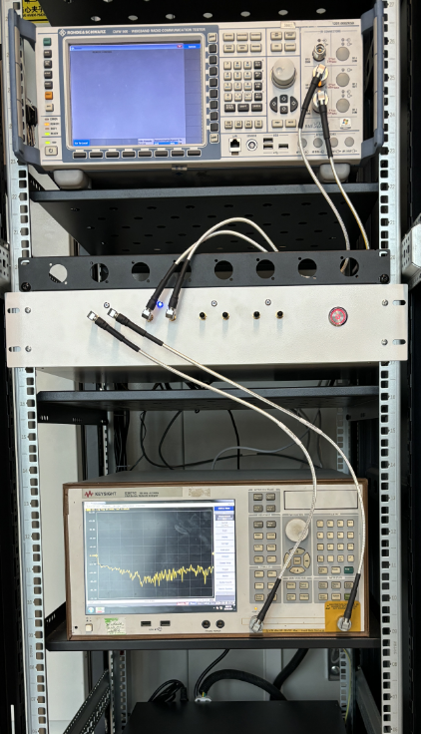
3.2 Test System 测试系统
Multi-probe spherical near-field anechoic chamber test system that meets the relevant international regulations such as CTIA and 3GPP, a multi-functional wireless test system with excellent performance in radio frequency, absorption, and mechanical structure. The system has high integration and reliability. It supports pendulum sampling frequency-doubling technology and can be adapt to the testing needs of small multi-lobed antennas. It is suitable for the wireless testing of small high-integration electronic devices such as IoT devices, drone modules, car machine modules, smart home devices, and mobile communication equipment. It can also meet the testing needs of ceiling antennas, miniature base stations, and embedded routers, etc., which have high dependence on the passive performance of antennas.
多探头球面近场空口暗室测试系统，符合CTIA和3GPP等相关国际法规的多功能无线测试系统。该系统在射频、吸波和机械结构等有良好的表现，系统的集成度和可靠性较高。系统支持摇摆式采样倍频技术，可适应小型多副瓣天线的测试需求，适用于物联网、无人机、车机模块、智能家居、移动通信设备等小型高集成度电子设备的无线测试。同时也可满足吸顶天线、微型基站、嵌入式路由器等对天线无源性能依赖度高的无线设备测试。
Supported Bnad 可支持频率 | 600MHz-9GHz (Expand. 12GHz)
Test Item 测试内容 | Passive: Gain/Efficiency/2D/3D radiation/non-circularity(不圆度)/axial ratio(轴比）... Active: TRP/TIS/EIRP/EIS
测试制式 Test Standard | 2G/3G/4G/5G/Wi-Fi b/g/n/a/ac/ax/蓝牙 /NB-IOT /Cat-M (eMTC)/GPS/BEIDOU/GLONASS/ZigBee/LoRa(Non-signaling 非信令)...

Slide 9
3.3. Efficiency & Gain 效率&增益
Frequency (MHz) | Efficiency (%) | Gain .dB | Frequency (MHz) | Efficiency (%) | Gain .dB
860 | 52.48 | 1.9 | 892 | 46.34 | 2.6
862 | 51.52 | 1.84 | 894 | 45.92 | 2.6
864 | 51.05 | 1.86 | 896 | 44.98 | 2.45
866 | 51.29 | 1.9 | 898 | 44.57 | 2.31
868 | 51.52 | 1.91 | 900 | 46.13 | 2.39
870 | 50.58 | 1.85 | 902 | 46.99 | 2.39
872 | 51.52 | 2.09 | 904 | 47.32 | 2.37
874 | 47.32 | 2.23 | 906 | 47.21 | 2.33
876 | 47.97 | 2.53 | 908 | 46.88 | 2.3
878 | 49.55 | 2.73 | 910 | 46.03 | 2.22
880 | 52.12 | 3.01 | 912 | 46.03 | 2.21
882 | 50.35 | 2.81 | 914 | 46.45 | 2.21
884 | 48.64 | 2.7 | 916 | 46.45 | 2.15
886 | 47.86 | 2.68 | 918 | 46.34 | 2.06
888 | 47.42 | 2.66 | 920 | 46.77 | 2.15
890 | 46.13 | 2.49 | AVG | 48.12 | 2.32

Slide 10
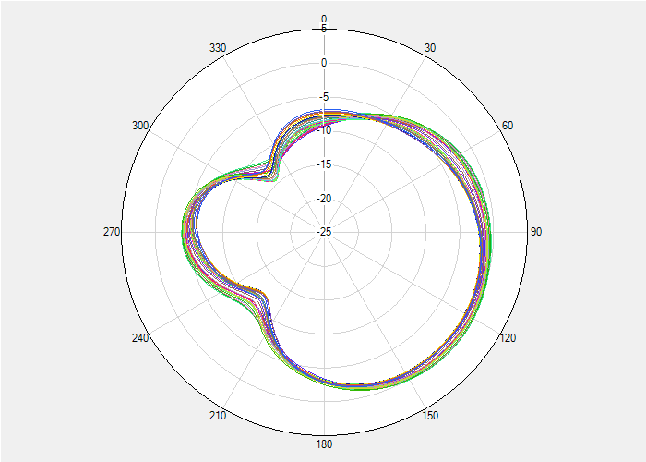
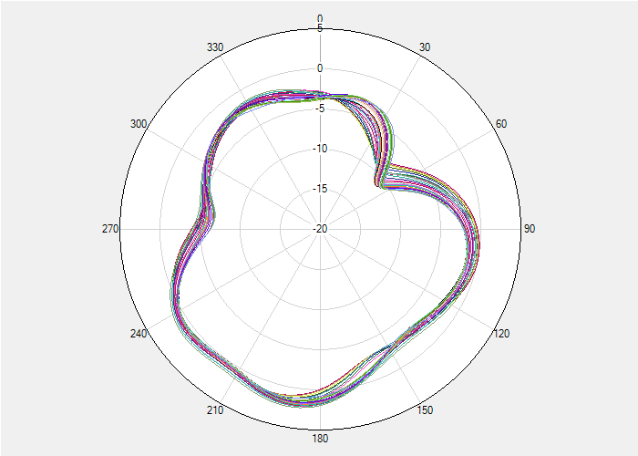
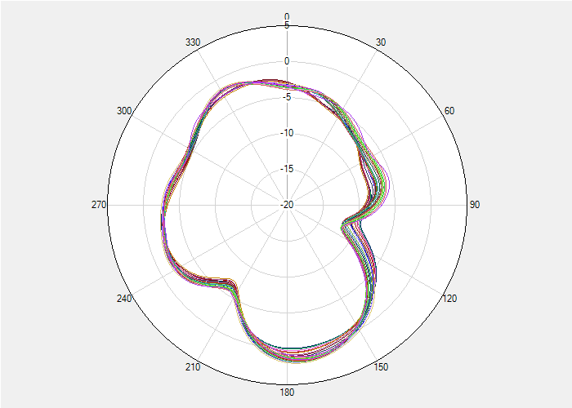
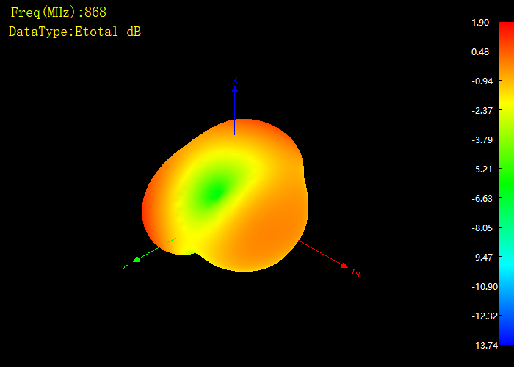
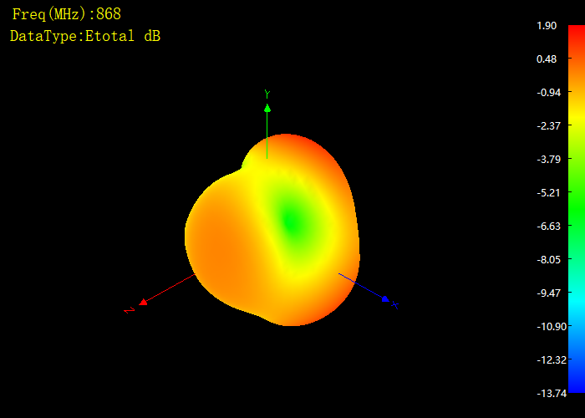
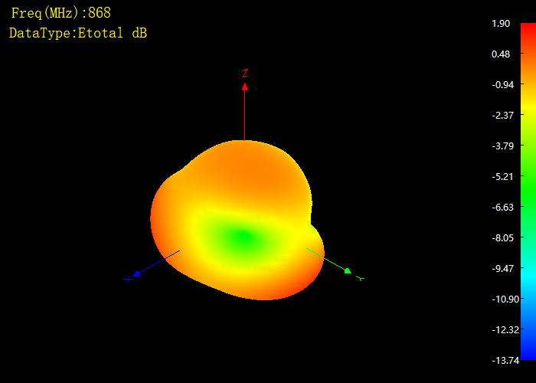
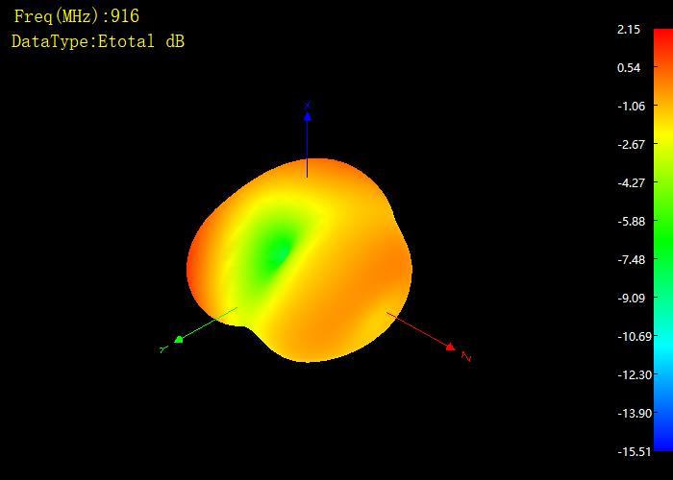
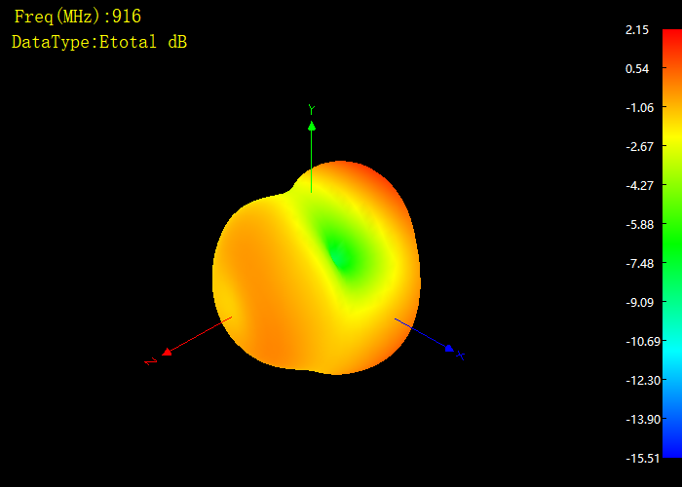
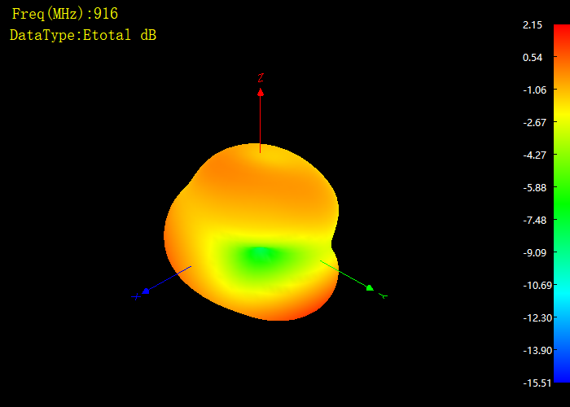
3.4. 2D Ridiation Model 2D辐射模型
Frequency(MHz) | XOY-plane | XOZ-plane | YOZ-plane
860-920
3.5. 3D Ridiation Model 3D辐射模型
Frequency(MHz) | XOY-plane | XOZ-plane | YOZ-plane
868
916

